Slide 1
CSE523 - Machine Learning
Group - 18: The Curators
Breast Cancer Detection
Student Name | Student ID
Harsh Patel | AU1940114
Kavan Desai | AU1940126
Sarthak Bharad | AU1940176

Slide 2
Introduction
Breast Cancer begins when healthy cells in the breast undergo change and grow out of control, forming a mass or sheet of cells called a tumor.
A tumor can be malignant (cancerous) or benign.
Breast cancer has currently overtaken lung cancer as the most commonly diagnosed cancer in women worldwide (according to statistics released by the International Agency for Research on Cancer (IARC^{[1]}) in December 2020).
Notes:
[1] URL: https://www.iarc.who.int/featured-news/world-cancer-day-2021/
Website title: World Health Organization
Date accessed: April 24, 2022

Slide 3
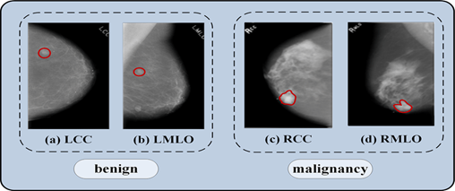
Problem Statement
To predict the state of tumor i.e. malignant or benign based on certain characteristics of the cell using classical machine learning algorithms.

Slide 4
Dataset Information^{[2]}
Attribute Information:
1) ID number 2) Diagnosis (M = malignant, B = benign)
Ten real-valued features are computed for each cell nucleus:
a) radius (mean of distances from center to points on the perimeter)
b) texture (standard deviation of gray-scale values)
c) perimeter
d) area
e) smoothness (local variation in radius lengths)
f) compactness (perimeter^2 / area - 1.0)
g) concavity (severity of concave portions of the contour)
h) concave points (number of concave portions of the contour)
i) symmetry
j) fractal dimension ("coastline approximation" - 1)
The mean, standard error and "worst" or largest (mean of the three largest values) of these features were computed for each image, resulting in 30 features. For instance, field 3 is Mean Radius, field 13 is Radius SE, field 23 is Worst Radius.
All feature values are re-coded with four significant digits.
There are a total of 579 rows and 32 columns all consisting of images due to which the complexity is high.
Notes:
[2] URL: https://archive.ics.uci.edu/ml/datasets/Breast+Cancer+Wisconsin+%28Diagnostic%29
Website title: UCI Machine Learning Repository: Breast Cancer Wisconsin (Diagnostic) Data Set
Date accessed: April 24, 2022

Slide 5
Existing Solutions/Body of Work
There are both model-based and model-free techniques for Breast Cancer Prediction using Machine Learning.
The model-based approaches include^{[3]}:
1) Generalized Linear Models (GLM)
2) Logistic Regression (LOGIT)
3) Linear Discriminant Analysis (LDA)
4) Quadratic discriminant Analysis (QDA)
5) Markov Chain Monte Carlo Generalized Linear Mixed Model (MCMC GLMM)
The model-free predictive analytics involve^{[3]}:
1) Adaptive Boosting Algorithm (ADA)
2) Random Forest (RF)
3) k-Nearest Neighbors (KNN)
Notes:
[3] Article title: Machine Learning Algorithms For Breast Cancer Prediction And Diagnosis
URL: https://www.sciencedirect.com/science/article/pii/S1877050921014629
Website title: Procedia Computer Science
Date accessed: April 24, 2022

Slide 6
Our Approach
texture_worst
compactness_mean
smoothness_worst
Clearing, Merging, EDA…..
concavity_worst
Data Preprocessing
radius_mean
id
Prediction
Training suitable models
Machine Learning Algorithms
Classification
Random Forest
Predicting whether Malignant or Benign
Feature Importance
Principal Component
Analysis

Slide 7
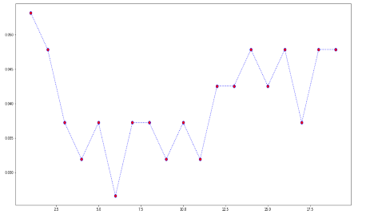
Results of the Work performed
k-Nearest Neighbours:
kNN is used for both classification and regression.
Here we have used kNN as the features of the cell are correlated with each other and the cancerous cell can be classified based on the neighbours.
We used the Euclidean distance in implementation of KNN algorithm.
For the best suitable K, we implemented the mean squared analysis (MSE) over a range of values of K from 1-20.
And as a result, we could conclude that the least error valued K gives approximately 97% accuracy.

Slide 8
Our Approach
Univariate Feature Selection
Random Forest
Recursive Feature Elimination
Finding important Features
Principal Component Analysis
Recursive Feature Elimination with Cross validation

Slide 9
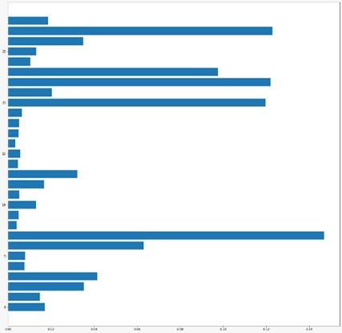
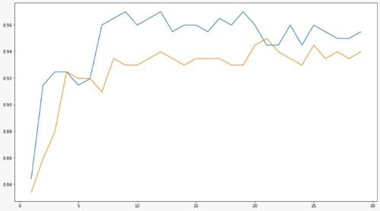
Our Approach
Results of Random Forest

Slide 10
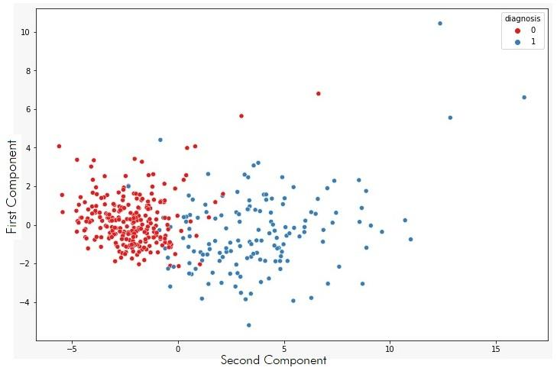
Our Approach
Principal Component Analysis
Finding important Features
Random Forest

Slide 11
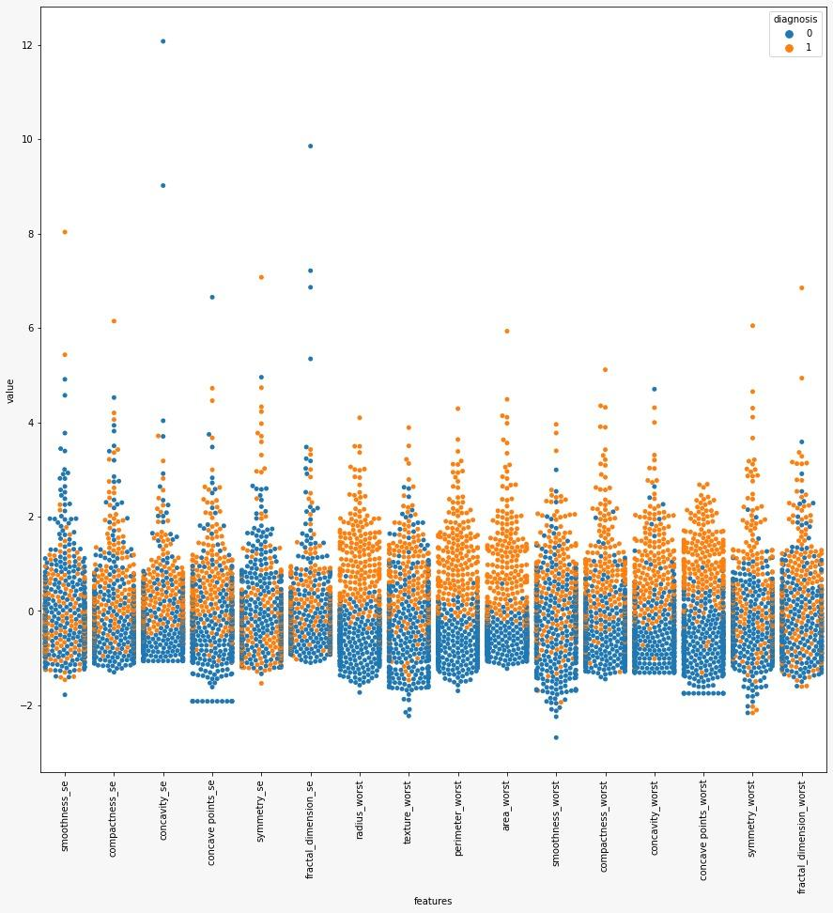
Results of the Work performed
Manual correlation results

Slide 12
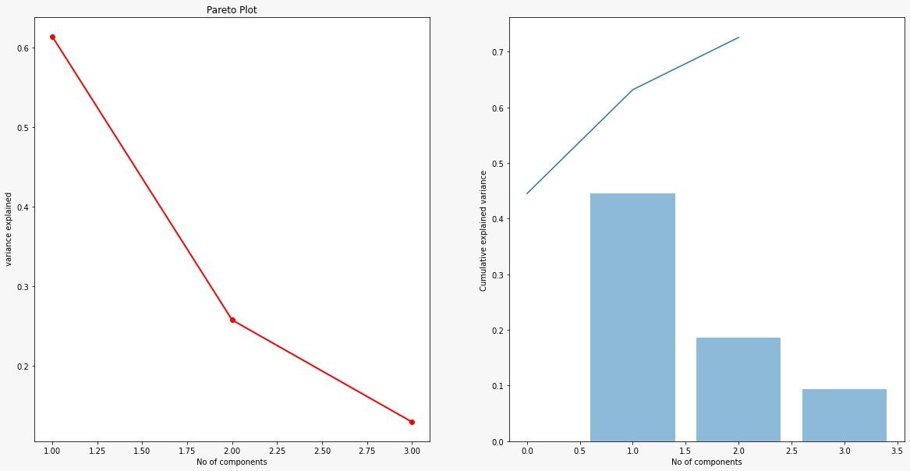
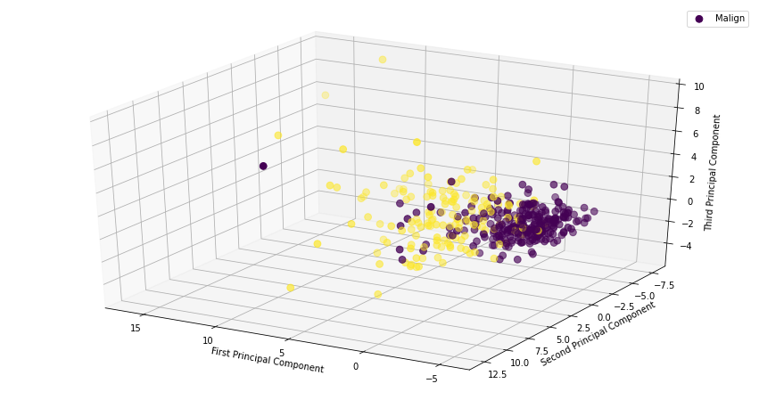
Results of the Work performed
PCA
Simplifies the complexity in high-dimensional data while retaining trends and patterns basically reduce dimensionality
PCA is user to process data where multi-colinearity exists between the features/variables
Use 3 components to generate PCA.

Slide 13
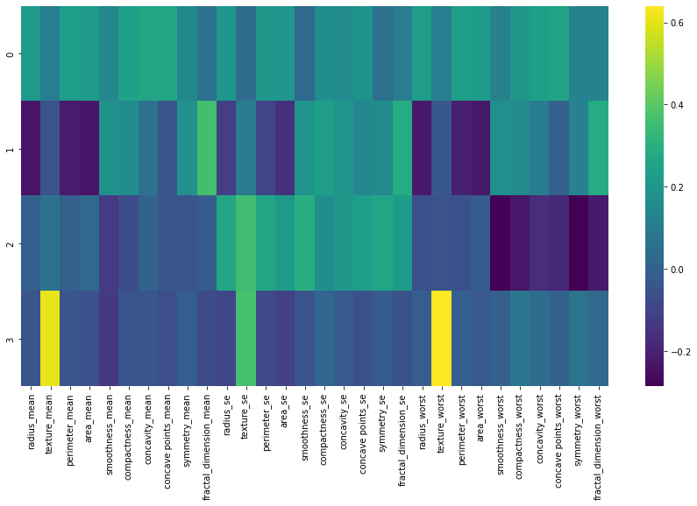
Results of the Work performed
PCA
Get best fit line based on the Principal component.

Slide 14
Conclusion
We found that in Knn Euclidean distance is better option that manhattan distance in terms of accuracy as data gets overfit.
We use K fold cross validation to intrinsically identify the best validation set which performs better that other, So we used the Cross validation process to get the best features suitable for the dataset.
Using PCA we create 3 components and we found that we get the best fit from the relation between first and second component analysis.
We found that the variation in correlation between features and Principal components is varied in nature where as it is positive near to zero which helps us differentiate two class.

Slide 15
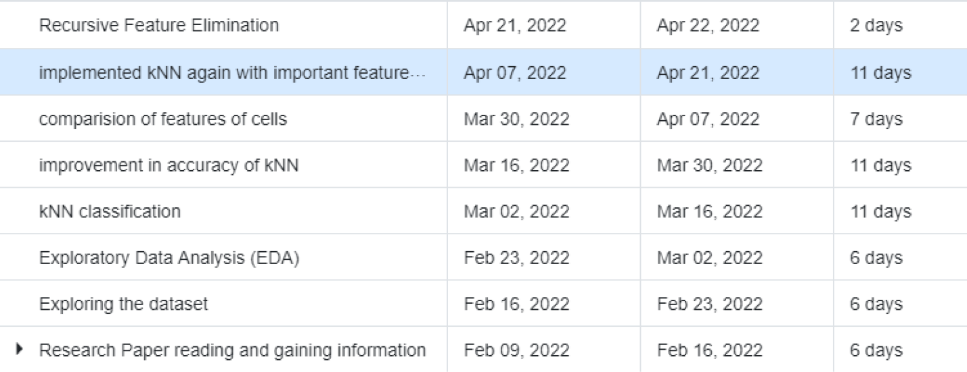
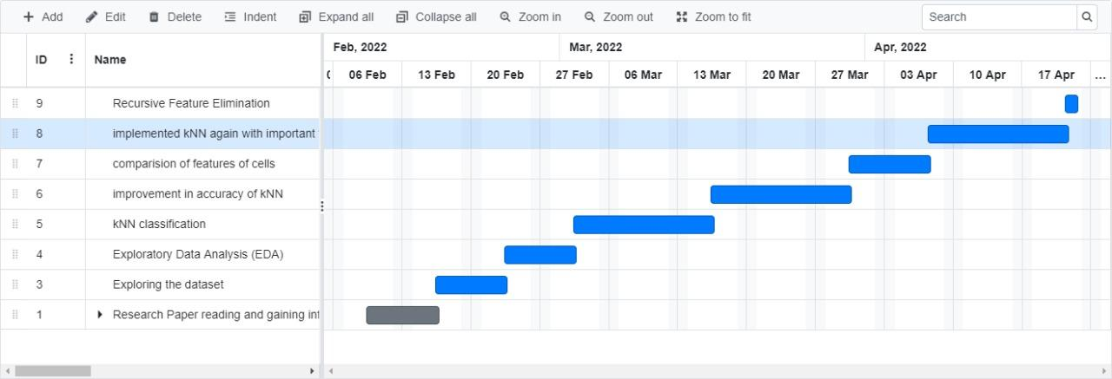
Gantt Progress Chart

Slide 16
Contribution of Members
 | Harsh Patel | Kavan Desai | Sarthak Bharad
EDA | ✔ |  | ✔
kNN | ✔ | ✔ | ✔
Logistic Regression | ✔ | ✔ | ✔
Data Pre-Processing |  | ✔ | ✔
Random Forest | ✔
Principal Component Analysis |  | ✔

Slide 17
References
UCI Machine Learning Repository: Breast Cancer wisconsin (diagnostic) data set. [Online]. Available: https://archive.ics.uci.edu/ml/datasets/Breast+Cance r+Wisconsin+%28Diagnostic%29. [Accessed: 20- Mar-2022].
“Breast cancer - introduction,” Cancer.Net, 31-Dec- 2020. [Online]. Available: https://www.cancer.net/cancer-types/breast- cancer/introduction. [Accessed: 20-Mar-2022].
M. A. Naji, S. E. Filali, K. Aarika, E. L. H. Benlahmar, R. A. Abdelouhahid, and O. Debauche, “Machine learning algorithms for breast cancer prediction and diagnosis,” Procedia Computer Science, 08-Sep-2021. [Online]. Available: https://www.sciencedirect.com/science/article/pii/S 1877050921014629. [Accessed: 20-Mar-2022].
Upadhayay, A., 1970. Empirical comparison by data mining classification algorithms ( C 4 . 5 &amp; c 5 . 0 ) for Thyroid Cancer Data Set . Semantic Scholar. Available at: https://www.semanticscholar.org/paper/Empirical- Comparison-by-data-mining-Classification- Upadhayay/6e6d581cf8a96559a91d74274b765b62b de9d4b7 [Accessed March 20, 2022].
R. Turkki, D. Byckhov, M. Lundin, J. Isola, S. Nordling, P. E. Kovanen, C. Verrill, K. von Smitten, H. Joensuu, J. Lundin, and N. Linder, “Breast cancer outcome prediction with tumour tissue images and machine learning,” Breast cancer research and treatment, Aug-2019. [Online].Available: R. Turkki, D. Byckhov, M. Lundin, J. Isola, S. Nordling, P. E. Kovanen, C. Verrill, K. von Smitten, H. Joensuu, J. Lundin, and N. Linder,“Breast cancer outcome prediction with tumour tissue images and machine learning,” Breast cancer research and treatment, Aug-2019. [Online].https://www.ncbi.nlm.nih.gov/pmc/articles/PMC66 47903/. [Accessed: 20-Mar-2022].. [Accessed: 20- Mar-2022].
M. Montazeri, M. Montazeri, M. Montazeri, and A. Beigzadeh, “Machine learning models in breast cancer survival prediction,” Technology and Health Care, 01-Jan-2016. [Online]. Available: https://content.iospress.com/articles/technology- and-health-care/thc1071. [Accessed: 20-Mar-2022].

